Slide 1
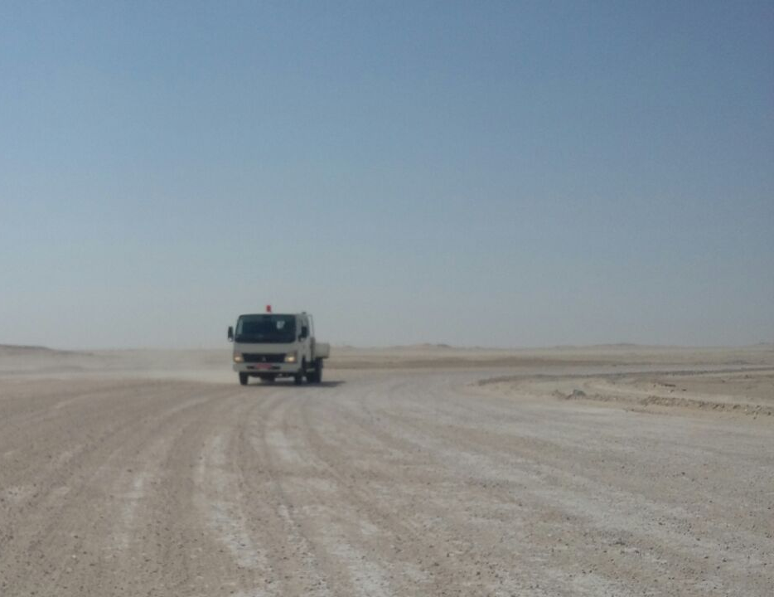
ATE–MVI, AD - 24.04.2017
Date: 24.04.2017 Incident: MVI-AD
What happened?
An instrument crew consist of 06 personnel including driver on their way to base in a 03 ton canter on completion of day’s job , rolled over while negotiating a sharp left bend on a graded road. All occupants escaped unhurt and slight damages to the vehicle.
Your learning from this incident..
Drivers :
Always negotiate bends at safe speed.
Always be cautious while applying brakes if you lose control of the vehicle
Always slow down before the bend.
Co- Passenger and Occupants :
Remind the driver about the approaching bends, road damages.
Intervene if the driver is over speeding
Slow down before the bend

Slide 2
Management self audit
Date: 24.04.2017 Incident: MVI-AD
As a learning from this incident and ensure continual improvement all contract
managers must review their HSE HEMP against the questions asked below
Confirm the following:
Do you ensure that Journey manager’s are briefed about the route prior to JM plan issued ?
Do your drivers adhere to the posted speed limit on the roads?
Do you have a reporting procedure in place about the road conditions?
Do you ensure that your drivers are alerted prior to sharp curves and other hazards on the road?
Notes:
Make a list of closed questions (only ‘yes’ or ‘no’ as an answer) to ask other contractors if they have the same issues based on the management or HSE-MS failings or shortfalls identified in the investigation. Pretend you have to audit other companies to see if they could have the same issues.

