Slide 1
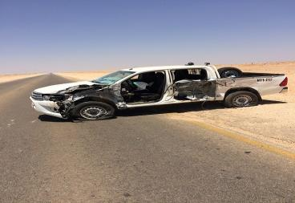
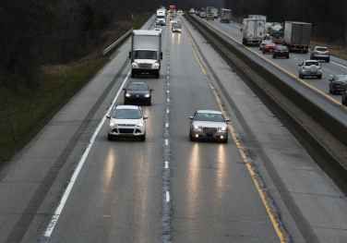
PDO Second Alert
Date: 06.05.2017 Incident title: MVI
What happened?
At approximately 12:32 pm A pickup travelling from Amin to Nimr was involved in a side swipe MVI. Around 5km from Nimr roundabout, the driver of the pickup veered across the traffic lane and into the side of an oncoming heavy vehicle and trailer. The pickup was close to the centre line at the time, the heavy vehicle driver has moved over to the right side but both drivers were unable to avoid the impact. The pick up has impacted the left side of the transfer reel load with the left side of the pickup before parting and coming to rest on the right side of the road to the side of the carriageway. The driver and passengers of the pickup were unharmed as was the driver of the heavy vehicle.
Your learning from this incident..
Always apply Defensive Driving technique while driving.
Always ensure you use your own IVMS Key
Always intervene if you witness unsafe driving behavior.
Always drive according to weather condition.
The Driver crossed Road center lane
STAY IN Your LANE

Slide 2
Management self audit
Date: 06.05.2017 Incident: MVI
As a learning from this incident and ensure continual improvement all contract
managers must review their HSE HEMP against the questions asked below
Confirm the following:
Do you ensure the driver follow defensive driving techniques?
Do your staff intervene when the driver drive unsafely ?
Do you have assurance process to ensure each individual is utilizing his own IVMS key?
Do you ensure that all employees aware of consequence management matrix for road safety non-compliance?
Notes:
Make a list of closed questions (only ‘yes’ or ‘no’ as an answer) to ask other contractors if they have the same issues based on the management or HSE-MS failings or shortfalls identified in the investigation. Pretend you have to audit other companies to see if they could have the same issues.

