Slide 1
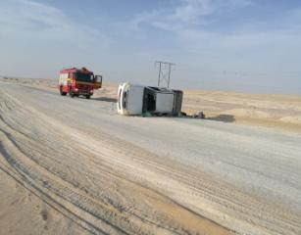

PDO Second Alert
Date: 16.05.17 Incident: MVI
What happened?
A Toyota pickup truck rolled over while coming from Hazeera to Bahja. The vehicle was moving on Zauliya road towards Bahja when approx. 23 km away from Bahja PDO camp while negotiating a curve on the graded road the driver lost control and the vehicle moved left to the upcoming lane. The driver tried to regain control but the vehicle skidded and rolled over 3 times.
Your learnings from this incident:
Always observe the speed limits on the graded road.
Always drive to the road conditions.
Always intervene with a driver if you feel that he does not drive safely.
Always ensure all newly hired drivers have a proper on-the-job indoctrination.
Always drive to the road conditions!

Slide 2
Management self audit
Date: 16.05.17 Incident: MVI
As a learning from this incident and ensure continual improvement all contract
managers must review their HSE HEMP against the questions asked below
Confirm the following:
Do you ensure all drivers are properly trained and competent?
Do you ensure you have a consequence management in place to deal with driving violations?
Do you ensure you have a clear HSE induction and on-the-job indoctrination process in place for all employees?
Do you ensure IVMS performance is monitored regularly and all counselling sessions are followed up?
Do you ensure you manage your LCCs effectively to keep full control over their driving to reduce the risks?
Notes:
Make a list of closed questions (only ‘yes’ or ‘no’ as an answer) to ask other contractors if they have the same issues based on the management or HSE-MS failings or shortfalls identified in the investigation. Pretend you have to audit other companies to see if they could have the same issues.

