Slide 1
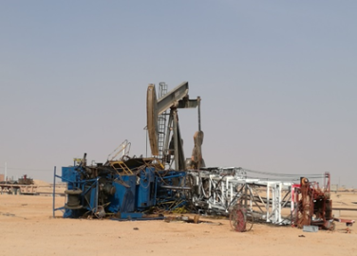
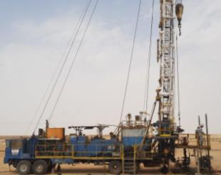
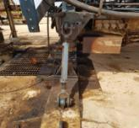
PDO Second Alert
Date: 30.06.2017 Incident: LTI
What happened?
During the raising of the mast, the Hoist became unstable due to uneven jacks levelling and tipped over trapping the driller between the hand rail and the ground resulting in a fracture to his right leg.
Your learning from this incident.
Always ensure the Rig carrier is levelled prior to set Up.
Always install Turnbuckle prior raising the mast.
Properly manage high risk areas by minimizing number of persons in area.
Conduct a Risk Assessment when the conditions change.
Check Level Setup prior Lifting & Lowering Operation
Turnbuckle installed

Slide 2
Management self audit
Date: 30.06.2017 Incident: LTI
As a learning from this incident and ensure continual improvement all contract
managers must review their HSE HEMP against the questions asked below
Confirm the following:
Do you conduct audits and inspections to ensure your supervisors are working safely?
Do you confirm the levelling of carrier at each rig up and or before any mast movements?
Does your SOP cover preparation of belly jacks prior to mast lowering (if your equipment requires this step)?
Do you manage high risk zones properly?
How well are your teams reporting Near Miss events?
Does your teams understand when MOC is required and do they document it?
Notes:
Make a list of closed questions (only ‘yes’ or ‘no’ as an answer) to ask other contractors if they have the same issues based on the management or HSE-MS failings or shortfalls identified in the investigation. Pretend you have to audit other companies to see if they could have the same issues.

