Slide 1
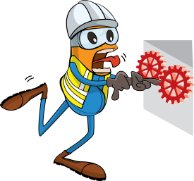
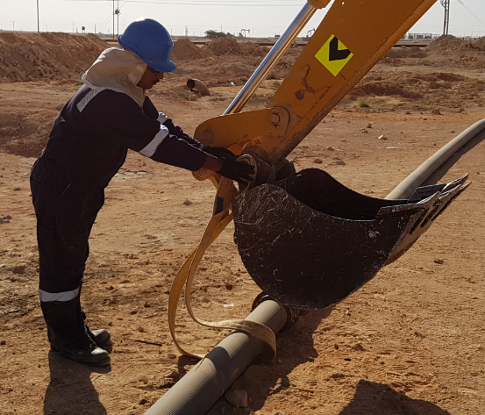
PDO Incident First Alert
Incident type | LTI (#43)
Date/ time | 29.11.17 at 14:15hrs | Directorate
Location | Amal | Dept
What happened
While connecting a sling to an excavator bucket, the bucket moved trapping the helper’s left hand between the bucket and the hinge pin resulting a fracture to his left hand little finger.
Mr. Musleh asks the questions of can it happen to you?
Do you ensure you identify all pinch points before starting work?
Do you ensure communication between all parties involved?
Do you ensure using the right equipment for the job?
Do you ensure you are out of the line of fire?
Please disseminate this LTI notification to your teams and use it in your tool box talks and HSE meetings and notice boards.

