Slide 1
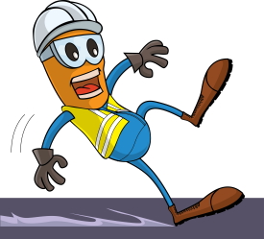
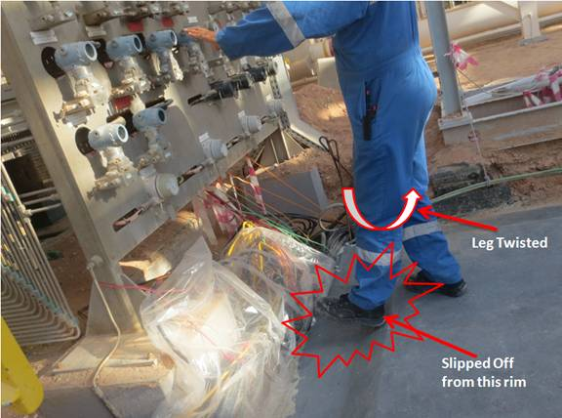
PDO Incident First Alert - PDO
Incident type | LTI (#44)
Date/ time | 15.12.17 at 10:50hrs | Directorate
Location | Yibal | Dept
What happened
While resetting a panel, The operator slipped off the edge of the new skid foundation losing his balance and twisting his left leg resulting in a fracture.
Mr. Musleh asks the questions of can it happen to you?
Do you ensure you identify all slip, trip, fall points before starting work?
Do you ensure you are wearing the correct type of foot wear?
Do you ensure you are standing in the right position to do the task?
Please disseminate this LTI notification to your teams and use it in your tool box talks and HSE meetings and notice boards.

