Slide 1
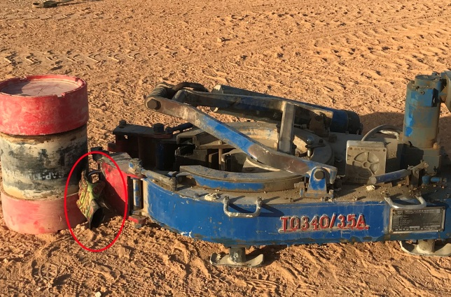
PDO Incident First Alert
Incident type | LTI (#45)
Date/ time | 30.12.2017 at 00:45 hrs. | Directorate
Location | Rig-80 Nimr | Dept
What happened
While running 9 5/8” casing in the hole, the crew attempted to latch the hydraulic power tong to the casing, the Floorman opened the left door latch, trapping his fingers between the latch handle and the casing resulting in fractures to his left hand middle and ring fingers.
Mr. Musleh asks the questions of can it happen to you?
Do you ensure you keep your hands and fingers away from pinch points?
Do you consider what could go wrong?
Do you ensure you are out of the “Line of fire”?
Pinch point
Please disseminate this LTI notification to your teams and use it in your tool box talks and HSE meetings and notice boards.

