Slide 1

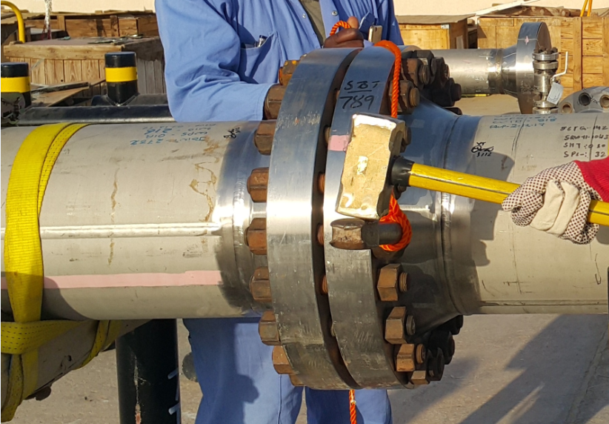


PDO Incident First Alert
Incident type | LTI (#46)
Date/ time | 22.07.2017 at 09:30 hrs. | Directorate
Location | Saih Nahadh Oil Station | Dept
What happened
While a fabricator was hammering a spanner, a splinter from the hammer went through the glove hitting cutting his right hand index finger causing tearing the tendon in his index finger.
Mr. Musleh asks the questions of can it happen to you?
Do you always use tools that are fit for use?
Do you ensure you are out of the “Line of fire”?
Do you consider what could go wrong?
Please disseminate this LTI notification to your teams and use it in your tool box talks and HSE meetings and notice boards.

