Slide 1
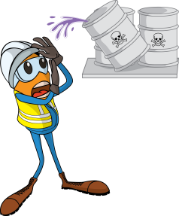
PDO Incident First Alert
Incident type | LTI (01)
Date/ time | 30.01.18@ 02:00hrs | Directorate
Location | Nimr | Dept
What happened
While an Assistant Driller (AD) was working on the mud system, a Roustabout was walking on the platform above carrying a container when particles of caustic soda fell from an opening in the bottom of it. The caustic soda entered the AD’s right eye and cheek as he looked up resulting in chemical burns.
Mr. Musleh asks the questions of can it happen to you?
Do you ensure you dispose of used chemical containers from site?
Do you have the correct PPE for the hazards on site?
Do you ensure the correct equipment is available and used on site?
Please disseminate this LTI notification to your teams and use it in your tool box talks and HSE meetings and notice boards.

