Slide 1
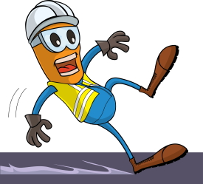
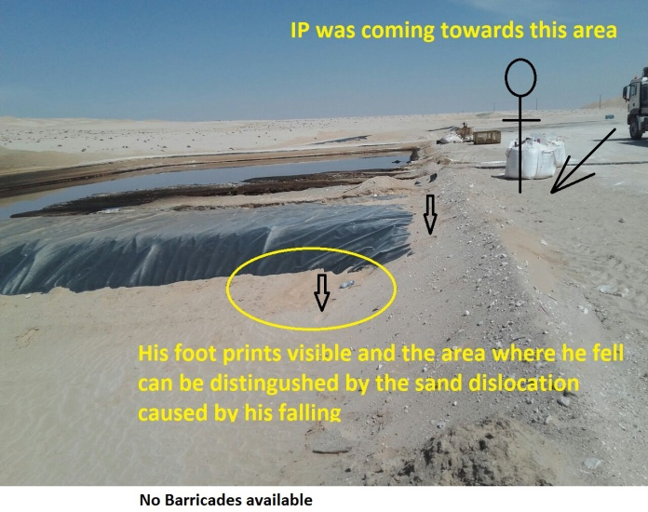
PDO Incident First Alert
Incident type | LTI (04)
Date/ time | 11.02.18 @09:00hrs | Directorate
Location | Bahja | Dept
What happened
After delivering water to Hoist 65 a helper walked across site to find a bathroom when he slipped on a pit liner and fell landing on his left hand resulting in a fracture to his left wrist.
Mr. Musleh asks the questions of can it happen to you?
Do you ensure you have been inducted on site?
Do you ensure pits are adequately barricaded?
Do you ensure you identify all hazards around the worksite?
Do you ensure you are wearing the correct footwear?
Please disseminate this LTI notification to your teams and use it in your tool box talks and HSE meetings and notice boards.

