Slide 1
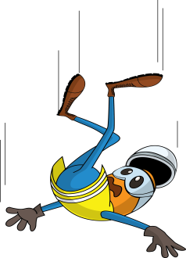
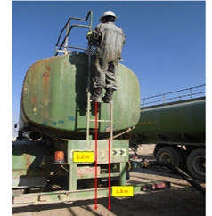
PDO Incident First Alert
Incident type | LTI (03)
Date/ time | 10.02.18 @14:15hrs | Directorate
Location | Bahja | Dept
What happened
While the driver was climbing down the water tanker ladder, his foot slipped causing him to fall to the ground landing on his ankle resulting in a fracture to his left heel.
Mr. Musleh asks the questions of can it happen to you?
Do you ensure you have adequate controls when working at height?
Do you ensure you always have 3 points of contact when using ladders?
Do you ensure your boots and gloves are clean?
Please disseminate this LTI notification to your teams and use it in your tool box talks and HSE meetings and notice boards.

