Slide 1
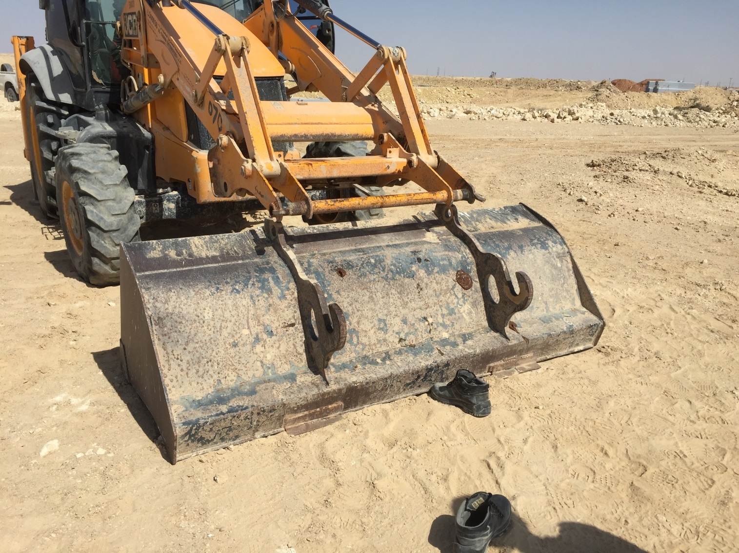
PDO Incident First Alert
Incident type | LTI (05)
Date/ time | 21.02.18 @11:10hrs | Directorate
Location | Marmul | Dept
What happened
During the maintenance of a JCB, an operator was disconnecting the bucket when the bucket fell on his right foot resulting in a crush injury.
Mr. Musleh asks the questions of can it happen to you?
Do you ensure that you are stood in a safe place?
Do you ensure you identify all hazards before starting a task?
Do you ensure you are out of the “Line of Fire”?
Crush point
Please disseminate this LTI notification to your teams and use it in your tool box talks and HSE meetings and notice boards.

