Slide 1
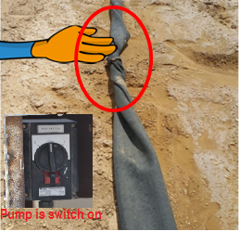
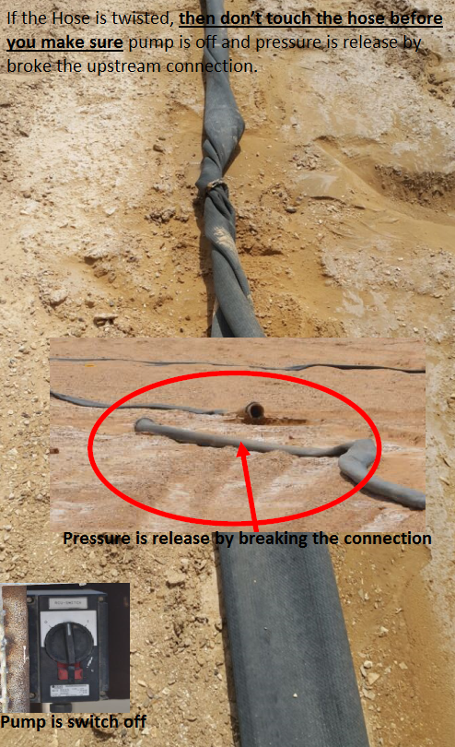
PDO Second Alert
Date: 08.05.17 Incident Type: LTI
What happened?
The Drill Water Service crew (Supervisor & Helper) were checking the water hose when they discovered a significant twisting of the hose line. They decided to turn on water pump to straighten up the twisted hose. During this process, the Helper who was holding the hose got his left arm entangled resulting in multiple fractures to his upper and lower left arm and fingers.
Your learning from this incident.
Always ensure new staff are inducted .
Always ensure workers are trained and supervised.
Always ensure adequate TBTs and that hazards are discussed prior to starting work.
Ensure you keep yourself out of the “ Line of the fire” while performing the task.
Keep away form ‘line of fire’

Slide 2
Management self audit
Date: 08.05.17 Incident Type: LTI
As a learning from this incident and to ensure continual improvement all contract managers must review their HSE HEMP against the questions asked below:
Confirm the following:
Do you ensure all new workers/supervisors are inducted on site and are educated in the hazards associated with the tasks?
Do you ensure effective TBTs are conducted before your team starts any task?
Do you ensure your HEMP identify all hazards including routine tasks?
Do you conduct work observations to identify potential hazards?
Do you discuss the potential hazards of routine activities with your employees?
Do your supervisors intervene in unsafe acts?
Do you ensure learning from previous incidents is communicated to and understood by all workers?
Do you ensure all actions from Incidents, audits, site visits, etc are closed out with adequate evidences?
Notes:
Make a list of closed questions (only ‘yes’ or ‘no’ as an answer) to ask other contractors if they have the same issues based on the management or HSE-MS failings or shortfalls identified in the investigation. Pretend you have to audit other companies to see if they could have the same issues.

