Slide 1
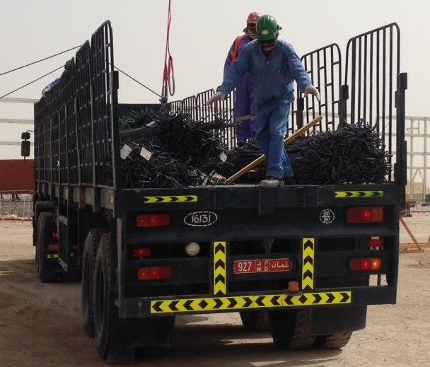
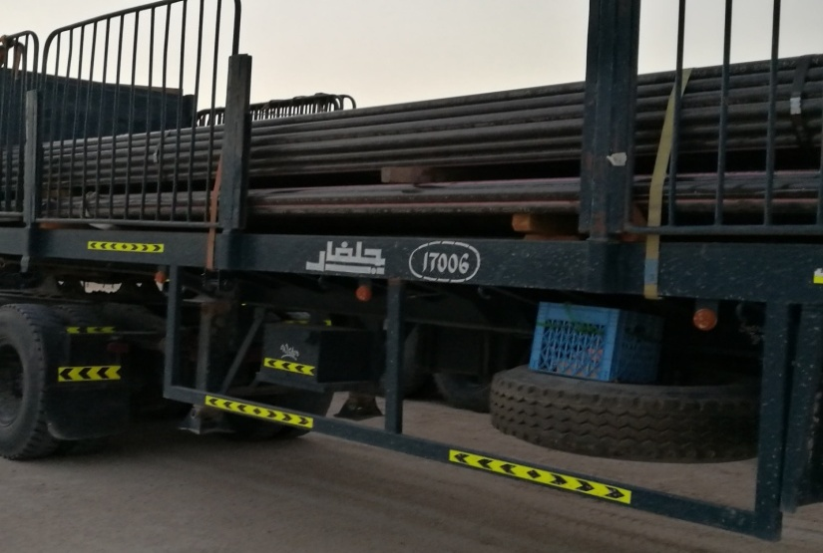
PDO Second Alert
Date: 20.07.17 Incident Type: LTI
What happened?
On Thursday 20th July 2017 during unloading of steel rebar bundle using a crane, a steel fixer was assisting a rigger on the bed of a trailer, which was at about 1.5 m off the ground.
The steel fixer was placing wooden skids below the steel rebar bundle to create space for inserting the lifting gear. After the lifting gear had been inserted and while the load was being lifted, an 8mm binding rod used for securing the bundle snapped off, resulting in a sudden, loud noise. The loud noise startled the steel fixer and he panicked and jumped from the trailer bed. He landed heavily on the ground on his right hand, which resulted in a fracture to his right wrist.
Your learning from this incident.
Ensure materials are correctly stacking to allow for safe loading and unloading
Ensure you have received the appropriate training for any task you are asked to perform
Carry out a proper tool box talk and ensure you are aware of the hazards involved in the task
Photo explaining how it should be done right

If in doubt – stop the job

Slide 2
Management self audit
Date: 08.05.17 Incident Type: LTI
As a learning from this incident and to ensure continual improvement all contract managers must review their HSE HEMP against the questions asked below:
Confirm the following:
Do you have a robust system to manage subcontractors?
Do you follow the Ten Point Checklist in assessing the subcontractors prior to engaging them?
Do you have a plan to ensure a system to deploy adequate resources for doing the job?
Do you ensure your subcontractors comply with Oman Labour Law especially regarding employees welfares?
Do you brief the workforce about emergency response, including the actions to take for medical emergencies?
Notes:
Make a list of closed questions (only ‘yes’ or ‘no’ as an answer) to ask other contractors if they have the same issues based on the management or HSE-MS failings or shortfalls identified in the investigation. Pretend you have to audit other companies to see if they could have the same issues.

