Slide 1
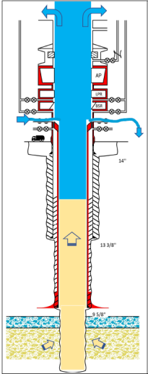
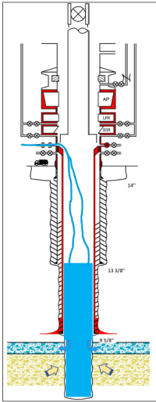
PDO Second Alert
What happened?
Operation was planned for retrieving the wear bushing. Driller partially opened Driller side wellhead Side Outlet Valve (SOV) to drain BOP. Driller changed over from Natih line and lined up the fill up line through wellhead SOV. While making up running tool (~1.2m) and test plug at rig floor, for retrieving wear busing, the rig floor crew observed well flowing. Driller operated the Blind Shear Ram (BSR) from the Koomey unit and the well was secured. During this time a splash of water was observed from the well center, rising upto a height of approx. 5m above rotary table. As a result, the running tool and test plug assembly got caught with the split bushing and popped out to rest 1m next to well center. After performing the gas test, Assistant Driller (AD) closed the partially opened SOV.
Your learning from this incident.
Maintain barriers at all times
Follow the procedure for adequately filling the well.
Always ensure adequate supervision is established for the task.
Ensure step by step written work instructions are provided for the task.
Operate the equipment only with proper authorisation.
Ensure the emergency process is followed.
Date: 27.07.17 Incident Type: HiPo
SOV Open
SOV Open driller side is open while pumping through Off driller side SOV
SOV Open driller side is closed while pumping through Off driller side SOV
Identify, Verify & Monitor Barriers

Slide 2
Management self audit
Date: 27.07.17 Incident Type: LTI
As a learning from this incident and to ensure continual improvement all contract managers must review their HSE HEMP against the questions asked below:
Confirm the following:
Do you have a process to review the work instructions prior to your task?
Do you ensure PTW is effective?
Do you ensure competence of staff in Natih area?
Do you have consequence management in place?
Do you ensure Well Plans are received and discussed prior to commencement of program?
Do you ensure that update procedures are available to your rig sites?
Notes:
Make a list of closed questions (only ‘yes’ or ‘no’ as an answer) to ask other contractors if they have the same issues based on the management or HSE-MS failings or shortfalls identified in the investigation. Pretend you have to audit other companies to see if they could have the same issues.

