Slide 1
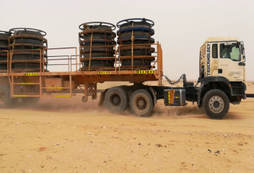

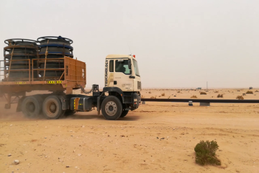

PDO Second Alert
Date: 20.07.2017 Incident: LTI
What happened?
A heavy driver while driving his vehicle on graded road entered a dip filled with loose soil; the vehicle stopped suddenly resulting in injury to his back.
Your learning from this incident..
Always Drive as per road conditions.
Ensure you know how your equipment works.
Always disclose medical history to employer.
Drive with appropriate speed to road conditions

Slide 2
Management self audit
Date: 20.07.2017 Incident: LTI
As a learning from this incident and to ensure continual improvement all contract managers must review their HSE HEMP against the questions asked below:
Confirm the following:
Do you remind your drivers to drive as per the road conditions?
Do you ensure that the employees have completed fitness to work?
Do you have a system to discuss hazards in daily TBT?
Do you have a system to declare previous medical condition?
Do you have a system to check the operational status of equipment?
Do you ensure familiarisation on operation of new equipments/device to your employees?
Notes:
Make a list of closed questions (only ‘yes’ or ‘no’ as an answer) to ask other contractors if they have the same issues based on the management or HSE-MS failings or shortfalls identified in the investigation. Pretend you have to audit other companies to see if they could have the same issues.

