Slide 1
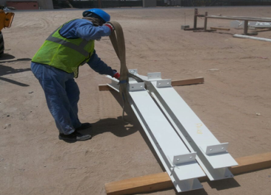
PDO Second Alert
Date: 13.08.2017 Incident title: LTI
What happened?
During fabrication of a shade, a rigger was fitting a sling around a beam for lifting when the beam became unbalanced causing it to fall over onto his left foot fracturing two of his toes.
Your learning from this incident..
Always ensure the load is stable and free from any entanglement
Encourage peers to intervene in unsafe actions
Always comply with the ten point lifting check list
Discuss line of fire in TRC sessions before start of job
Keep away from “Line of Fire”

Slide 2
Management self audit
Date: 13.08.2017 Incident: LTI
As a learning from this incident and to ensure continual improvement all contract managers must review their HSE HEMP against the questions asked below:
Confirm the following:
Do you always use the correct lifting method?
Do you ensure that staff are trained to identify safe place during lifting operations?
Do you ensure your permit holder identify and document the dynamic risk ?
Do you ensure you are out of the “Line of fire”?
Does the crew discuss about potential “line of fire” during TRIC sessions?
Do all tool box talks include discussion on hazards identified for the task?
Notes:
Make a list of closed questions (only ‘yes’ or ‘no’ as an answer) to ask other contractors if they have the same issues based on the management or HSE-MS failings or shortfalls identified in the investigation. Pretend you have to audit other companies to see if they could have the same issues.

