Slide 1
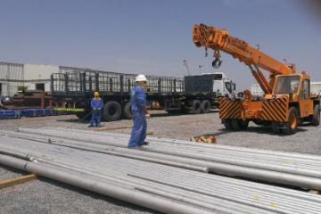
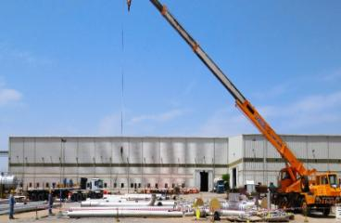
PDO Second Alert
Date:13.08.2017 Incident title: HiPo
What happened?
On 13th August 2017 at 11:45 hours inside a workshop workshop, while lifting a 3" stainless steel pipe with an Escort Hydra crane, the wire rope which was leading to 2.4 Ton Capacity Hook (weighing 400 Kg) snapped off and the Hook fell with the load to the ground. Due to the impact of the fall, two pipes (3" & 2“) got dent and damaged.
Your learning from this incident..
Ensure to use certified and maintained lifting equipment.
Ensure deployment of competent personnel.
Exercise empowerment to STOP Unsafe Act/Unsafe Condition
Always ensure a Lift Plan is in place.
Safety Critical Devices can Save the Lives & Protect Asset

Slide 2
Management self audit
Date:13.08.2017 Incident title: HIPO
As a learning from this incident and to ensure continual improvement all contract managers must review their HSE HEMP against the questions asked below:
Confirm the following:
Do all your Lifting Equipment meet PDO & International Standards?
Do you have Safety Critical Device such as Limit Switch on all Lifting Equipment?
Do you have maintenance record of the Lifting Equipment?
Do you have competent Operator to operate the Lifting Equipment?
5. Do you assure that daily inspection of Lifting Equipment is carried out?
6. Do you assess all Sub Contractors against 10 Point Checklist?
Notes:
Make a list of closed questions (only ‘yes’ or ‘no’ as an answer) to ask other contractors if they have the same issues based on the management or HSE-MS failings or shortfalls identified in the investigation. Pretend you have to audit other companies to see if they could have the same issues.

