Slide 1
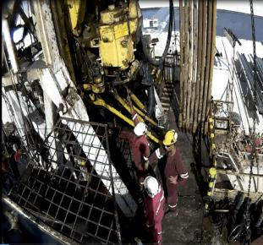
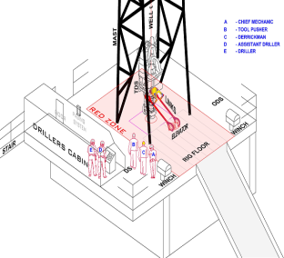
PDO Second Alert
Date:21.8.17 Incident title: Fatality
What happened?
While drilling the AD, under supervision of the TP inside the drilling console, observed an oil leak on the TDS. The TP called the CM to the rig floor to assess the problem. While the string was still rotating the TP left the Drillers console to join the CM on the rig floor to discuss the source of the leak. The DM joined the discussion. All three (3) were positioned between the TDS and the Drillers side Mast “A:” frame leg (within the Red Zone).
Suddenly the pipe handler assembly with the elevator installed to the bails rotated clockwise, crushing the CM him against the Mast “A” frame leg. The DM was struck by the elevators knocking him outward of the pipe setback area. Subsequently the TP was struck by the DM and was pushed towards the Drillers console.
The CM succumbed to his injuries while the DM and TP received minor injuries.
Your learning from this incident..
Always ensure the rotation of the drill string is stopped and isolated prior to performing any checks on the TDS
Always ensure Zone Management is enforced
Always ensure that all personnel are clear from the Line Of Fire
Always ensure competence of staff conducting the task
Always ensure hands free communication is tested and verified to ensure functionality
Consequence management to be applied to all breaches of Life Saving Rules (LSR’s)
A
B
C
Position of people before incident CM (A) DM (B) &TP (C)
Stay away from Red /No Go Zone
while equipment is in motion

Slide 2
Management self audit
Date:21.8.17 Incident title: Fatality
As a learning from this incident and to ensure continual improvement all contract managers must review their HSE HEMP against the questions asked below:
Confirm the following:
Do you ensure communications systems are working and maintained?
Do you ensure maintenance of safety critical equipment is monitored?
Do you have a system to effectively cascade the HSE Flashes, Product Bulletins & recommended actions to all staff?
Do you effectively manage the staff competency process at all levels?
Do you strictly enforce Zone Management process at your sites?
Do you have a full listing of all Safety Critical Equipment including Safety Critical Spares?
Do You always ensure any breakdown, testing or maintenance work is planned, risk assessed with TBT and PTW in place, prior to commencement of the work?
Notes:
Make a list of closed questions (only ‘yes’ or ‘no’ as an answer) to ask other contractors if they have the same issues based on the management or HSE-MS failings or shortfalls identified in the investigation. Pretend you have to audit other companies to see if they could have the same issues.

