Slide 1
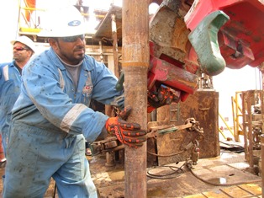
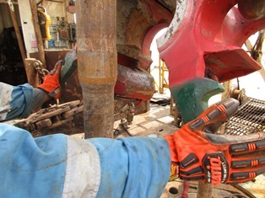
PDO Second Alert
Date: 18.8.2017 Incident title: LTI
What happened?
During picking up 4”DP joint the floor-man (FM) observed that the elevator is not in center of the tool joint and touching the pipe. FM tried to pull the elevator by holding it on left side of the latch and supporting the drill pipe with his right hand. At this time the elevator swung back trapping his left hand ring finger between the drill pipe and the elevator latch resulting in fracture.
Your learning from this incident..
Handle the equipment only if you are authorised
Handle the equipment by handles / at identified locations only
Identify pinch points and keep away
Stay out of “line of fire”
Always intervene and STOP the task if you witness Unsafe Acts
Always ask the 4 hands and fingers questions before you put your hands
Identify Pinch Points and keep your Hands & Fingers away

Slide 2
Management self audit
Date: 18.8.2017 Incident title: LTI
As a learning from this incident and to ensure continual improvement all contract managers must review their HSE HEMP against the questions asked below:
Confirm the following:
Do all crews have impact Gloves?
Do you effectively communicated your company’s empowerment to STOP policy?
Are your crew aware of being in the line of fire?
Have you identified all potential pinch point locations?
Have you trained your crew with the SOP appropriate for their job?
Do your crews record non compliance to SOP?
Do you ensure extra surveillance during the end of contract period?
Notes:
Make a list of closed questions (only ‘yes’ or ‘no’ as an answer) to ask other contractors if they have the same issues based on the management or HSE-MS failings or shortfalls identified in the investigation. Pretend you have to audit other companies to see if they could have the same issues.

