Slide 1
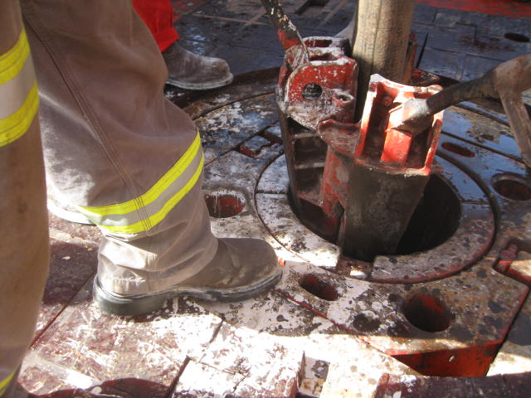
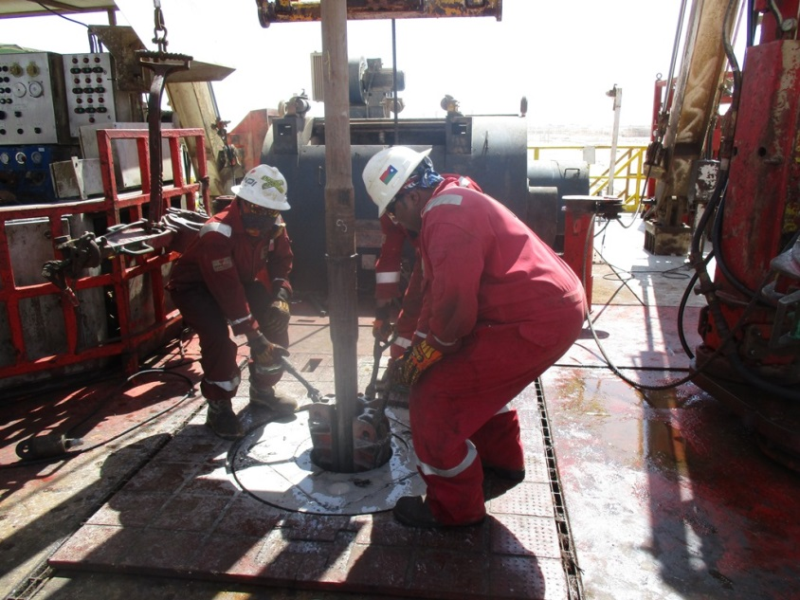
PDO Second Alert
Date: 27.08.17 Incident title: LTI
What happened?
On 27th August 2017 around 23:21 hrs, while drilling 12 ¼” top hole, a Floorman put the slips into the table to make a connection, the Floorman attempted to push the slips with his left foot at which time the Driller slacked off the drill string, the Floorman’s foot got caught between the rotary table and the top lip of the slips.
Your learning from this incident..
Always ensure you are out of the ‘line of fire’
Use stop work authority when you see a Unsafe Act or Condition
Ensure adequate supervisor at all times
Always review CCTV for assurance to procedures
Always ensure procedures are followed
Always use your hands to set the slips

Slide 2
Management self audit
Date: 27.08.17 Incident title: LTI
As a learning from this incident and to ensure continual improvement all contract managers must review their HSE HEMP against the questions asked below:
Confirm the following:
Do you monitor CCTV footage to ensure compliance to company policies and procedures?
Do you reward and empower the use of your STOP program?
Does your risk assessment take into account proper handling of slips?
Does the on shift Driller understand his responsibility for the safety of the crew?
Notes:
Make a list of closed questions (only ‘yes’ or ‘no’ as an answer) to ask other contractors if they have the same issues based on the management or HSE-MS failings or shortfalls identified in the investigation. Pretend you have to audit other companies to see if they could have the same issues.

