Slide 1
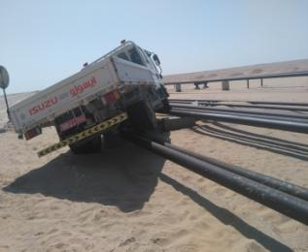
PDO Second Alert
Date: 27 August 2017 Incident title: HiPo
What happened?
An Isuzu truck skidded from a graded road and went onto a flow line while coming from Anzuz to Bahja. The vehicle was moving on Anzuz road towards Bahja while negotiating a curve on the graded road the driver lost control and the vehicle moved right to the sandy shoulder and further to the flow line. The driver failed to regain control and the vehicle kept moving on the flow line for 30 meters until it hit a pipe rack and stopped.
Your learnings from this incident..
Always drive to the road conditions
Always consider the flow lines along the road as a high risk
Always keep a reasonable distance between your vehicle and road shoulder
Always slow down when approaching a sharp bend on a graded road – even if a speed limit sign is not there
Always drive to the road conditions!

Slide 2
Management self audit
Date: 27 August 2017 Incident title: HiPo
As a learning from this incident and to ensure continual improvement all contract managers must review their HSE HEMP against the questions asked below:
Confirm the following:
Do you ensure all drivers are properly trained and competent?
Do you ensure you communicate all violations and consequences to your drivers in a language they understand?
Do you ensure all drivers understand and consider additional risks – such as flow lines and other production facilities – while driving?
Do you have an induction and orientation process for new drivers to ensure they are an integral part of safety culture in your organization?
Do you ensure you close out all actions from the previous similar incident and revisit them if there is a recurrence?
Notes:
Make a list of closed questions (only ‘yes’ or ‘no’ as an answer) to ask other contractors if they have the same issues based on the management or HSE-MS failings or shortfalls identified in the investigation. Pretend you have to audit other companies to see if they could have the same issues.

