Slide 1
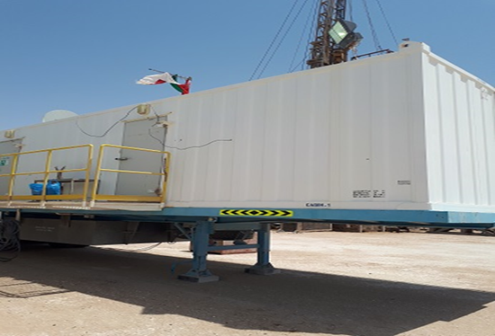
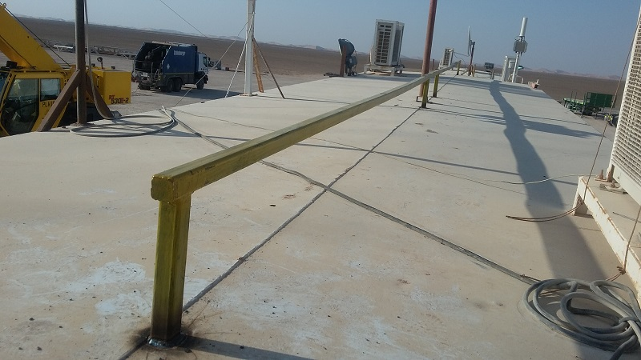
PDO Second Alert
Date: 31.08.2017 Incident title: LTI
What happened?
The Electrician was adjusting a TV satellite on top of the Rig Manager’s Caravan without fall protection equipment. He moved to the edge of the roof to pick up a cable when he lost consciousness and fell approximately 4.3 meters to the ground.
Your learning from this incident..
Ensure that all crew follow the working at height and PTW rules
Ensure that all crew wear fall protection equipment
Ensure suitable anchorage points are available and used
Ensure that crew members receive suitable rest periods and daily work tasks are understood and planned.
Photo explaining what was done wrong
Photo explaining how it should be done right
Fall protection harnesses must be used when working at height & suitably anchored
Always wear fall protection equipment when working at height

Slide 2
Management self audit
Date: 31.08.2017 Incident title: LTI
As a learning from this incident and to ensure continual improvement all contract managers must review their HSE HEMP against the questions asked below:
Confirm the following:
Do you ensure all your crew members are aware of the working at height rules and policies?
Do you ensure all crew members wear fall protection equipment when working at height?
Do you ensure that all potential working at height restrictions are known and suitable guards or anchor points are in place?
Do your Managers/Supervisors ensure suitable work planning and scheduling?
Do you ensure your crew members receive suitable rest periods following extended working hours and shift patterns?
Notes:
Make a list of closed questions (only ‘yes’ or ‘no’ as an answer) to ask other contractors if they have the same issues based on the management or HSE-MS failings or shortfalls identified in the investigation. Pretend you have to audit other companies to see if they could have the same issues.

