Slide 1
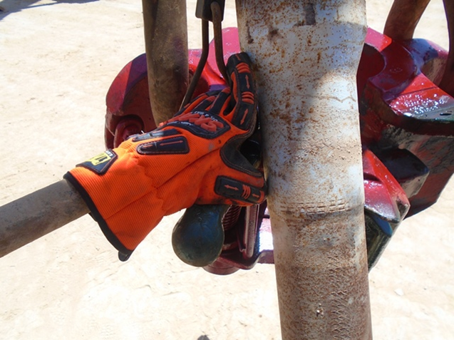
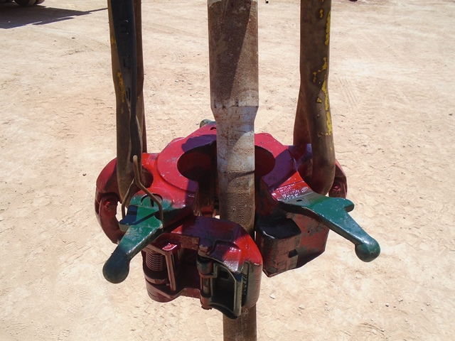
PDO Second Alert
Date: 01.09.2017 Incident title: LTI
What happened?
While Running in the hole 5'' drill pipe, the floor man was working on the monkey board in place of the derrick man. While trying to deliver the pipe to the elevator, he held the elevator handle with his left hand while moving the pipe forward with his right hand missing the target resulting in crush injury to the left hand thumb.
Your learning from this incident..
Always ensure you have identified pinch points
Ensure you stay out of line of fire
Discuss all hazards in the TBT including weather conditions
Always use hands off technique when delivering pipe into the elevator
No hands on elevator while delivering pipe

Slide 2
Management self audit
Date: 01.09.2017 Incident title: LTI
As a learning from this incident and to ensure continual improvement all contract managers must review their HSE HEMP against the questions asked below:
Confirm the following:
Do you ensure Supervisors include environmental hazards in the TBT?
Do your ensure the crews are aware of the risk of being in the line of fire?
Do you ensure your crews practice hands-off?
Do you ensure all crew members are competency assessed for their roles and any roles they may provide relief to?
Do you ensure effectiveness of communication of lateral learning’s and worksite incidents?
Notes:
Make a list of closed questions (only ‘yes’ or ‘no’ as an answer) to ask other contractors if they have the same issues based on the management or HSE-MS failings or shortfalls identified in the investigation. Pretend you have to audit other companies to see if they could have the same issues.

