Slide 1
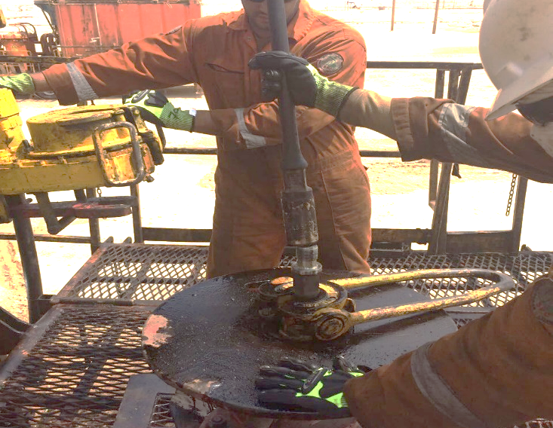
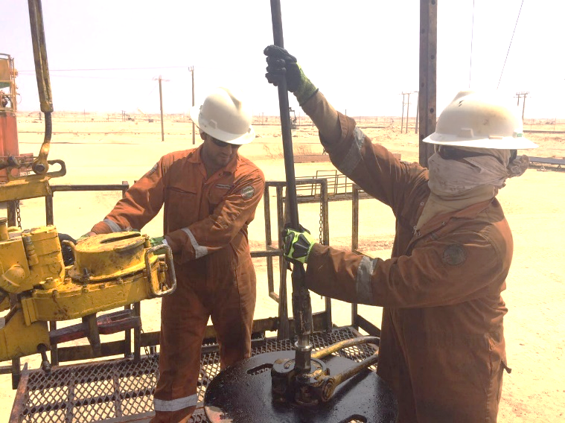
PDO Second Alert
Date: 19.9.2017 Incident: LTI
What happened?
While running the Sucker Rod (SR), the SR was hanging on the SR elevator. The Assistant Driller lowered the Travelling Block in order to make the connection. The Floorman was trying to guide the SR in order to be aligned. The Floorman tried to pull it into the correct position. The SR slipped off the connection and fell onto the SR BOP Table. The Floorman had his hand on the SR BOP Table. The SR hit the Floorman on his left hand little finger.
Your learning from this incident..
Ensure proper body posture and hand placement
Impact gloves are not there to prevent injuries, but to reduce potential consequences
Always use both hands at the right position for a 2 handed task
Keep your hands in a safe position
Proper guidance of SR

Slide 2
Management self audit
Date:19.9.2017 Incident: LTI
As a learning from this incident and to ensure continual improvement all contract managers must review their HSE HEMP against the questions asked below:
Confirm the following:
Do you ensure that the required hand positions are clearly stated in your SOP’s for the tasks?
Do your Competencies Assessments cover Hands & Finger Safety?
Do your SOP’s have a “Step back” for Safety if the task does not go as planned?
Do you conduct regulars checks to ensure procedures are still valid and being followed?
Do your management site visits/Coaching visits capture the needs of updating the SOP’s?
Notes:
Make a list of closed questions (only ‘yes’ or ‘no’ as an answer) to ask other contractors if they have the same issues based on the management or HSE-MS failings or shortfalls identified in the investigation. Pretend you have to audit other companies to see if they could have the same issues.

