Slide 1
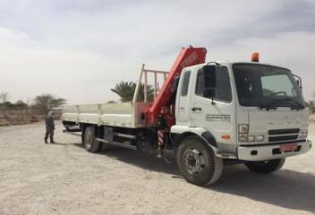
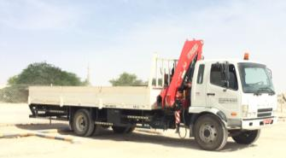
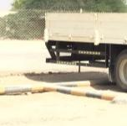
PDO Second Alert
Date: 18.08.2017 Incident: LTI
What happened?
An unmanned 7 Ton HIAB, which was under routine maintenance moved backward towards a parked mini bus. A mechanic who was walking in front of the minibus got entrapped in between the Hiab and mini bus and got injured. The person was taken to the PAC clinic and after initial medical attention he was shifted to SQH in Salalah for further examination.
Your learning from this incident..
Park the vehicle only on designated parking area.
Ensure hand brakes are fully engaged while parking.
Ensure wheel chocks are used while parking on slopes.
Ensure vehicle hand brake fully engaged
before commencing any maintenance activity.

Slide 2
Management self audit
Date: 18.08.2017 Incident: LTI
As a learning from this incident and ensure continual improvement all contract
managers must review their HSE HEMP against the questions asked below
Confirm the following:
Do you ensure all activities are covered under risk assessment?
Do you carryout maintenance of vehicle in approved area?
Do you make the team aware about the actions during medical emergencies?
Do you ensure compliance to the use of PPE?
5. Do you ensure effective fatigue management during TBT and Safety meetings?
Notes:
Make a list of closed questions (only ‘yes’ or ‘no’ as an answer) to ask other contractors if they have the same issues based on the management or HSE-MS failings or shortfalls identified in the investigation. Pretend you have to audit other companies to see if they could have the same issues.

Slide 3
PDO Second Alert
Translate whole slide to Arabic
Date: 18.08.2017 Incident: LTI
What happened?
An unmanned 7 Ton HIAB which was under routine maintenance moved backward towards a parked mini bus. A mechanic who was walking in front of the minibus got entrapped in between the Hiab and mini bus and got injured. The person was taken to the PAC clinic and after initial medical attention he was shifted to SQH Salalah for further examination.
Your learning from this incident..
Park the vehicle only on designated parking area
Ensure hand brakes are fully engaged while parking.
Ensure wheel chocks are used while parking on slopes.
Ensure vehicle hand brake fully engaged
before commencing any maintenance activity

Slide 4
Management self audit
Translate whole slide to Arabic
Date: 18.08.2017 Incident: LTI
As a learning from this incident and ensure continual improvement all contract
managers must review their HSE HEMP against the questions asked below
Confirm the following:
Do you ensure that all activities are covered under risk assessment?
Do you carryout maintenance of vehicle in approved area?
Do you make the team aware about the actions during medical emergencies?
Do you ensure compliance to the use of PPE?
5. Do you ensure effective fatigue management during TBT and Safety meetings?
Notes:
Make a list of closed questions (only ‘yes’ or ‘no’ as an answer) to ask other contractors if they have the same issues based on the management or HSE-MS failings or shortfalls identified in the investigation. Pretend you have to audit other companies to see if they could have the same issues.

