Slide 1
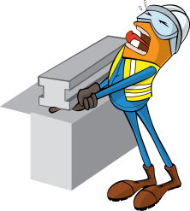
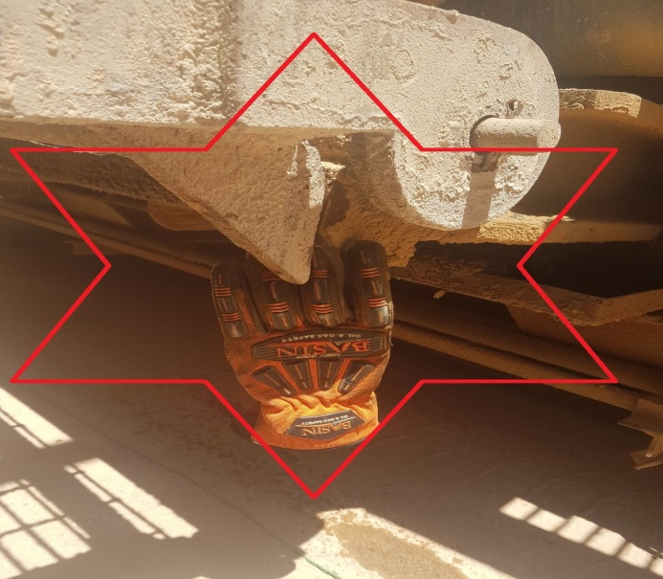
PDO Incident First Alert
Incident type | LTI (06)
Date/ time | 18.03.18 @16:30hrs | Directorate
Location | Marmul | Dept
What happened
While pushing a stone under the chassis for levelling the mud pump trailer in preparation to change a flat tire, the Rig Manager (RM) was holding the underside of a folded platform with 1 hand, when the platform released crushing his left hand causing a partial imputation in his ring finger and a crush in his middle finger.
Mr. Musleh asks the questions of can it happen to you?
Do you only do tasks you are authorized to do?
Do you ensure loads are properly secured?
Do you ensure you identify all hazards before starting a task?
Do you ensure you keep your hands and fingers away from pinch points?
Please disseminate this LTI notification to your teams and use it in your tool box talks and HSE meetings and notice boards.

