Slide 1
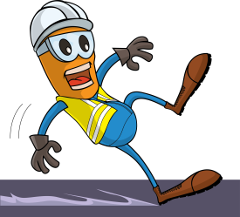
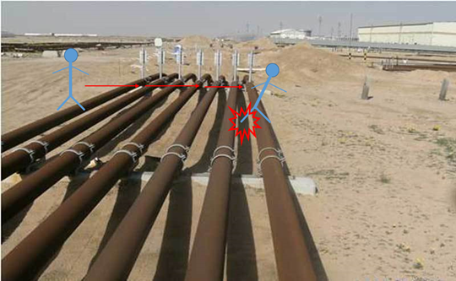


PDO Incident First Alert
Incident type | LTI (07)
Date/ time | 20.03.18 @11:25hrs | Directorate
Location | Lekhwair | Dept
What happened
While the supervisor was crossing parallel pipes, he slipped loosing his balance falling between pipes hitting his head on the pipe support. He suffered a cut in the head and a fracture in the right leg.
Mr. Musleh asks the questions of can it happen to you?
Do you watch your steps and avoid trap points?
Do you always use the crossing points?
Do you ensure you identify all hazards before starting a task?
Please disseminate this LTI notification to your teams and use it in your tool box talks and HSE meetings and notice boards.

