Slide 1
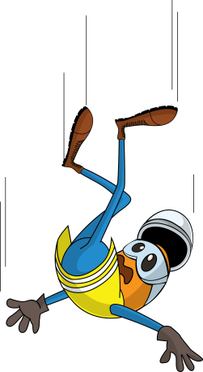
PDO Incident First Alert
Incident type | LTI (#11)
Date/ time | 29.04.18 @12:30hrs | Directorate
Location | Marmul | Dept
What happened
After checking his load security a driver was getting down from a low bed trailer when he lost his balance and fell resulting in a fracture to his left wrist.
Mr. Musleh asks the questions of can it happen to you?
Do you ensure you have safe access and egress?
Do you always ensure you keep 3 points of contact when climbing down?
Do you always consider if you can fall from height?
Fell from here
Please disseminate this LTI notification to your teams and use it in your tool box talks and HSE meetings and notice boards.

