Slide 1
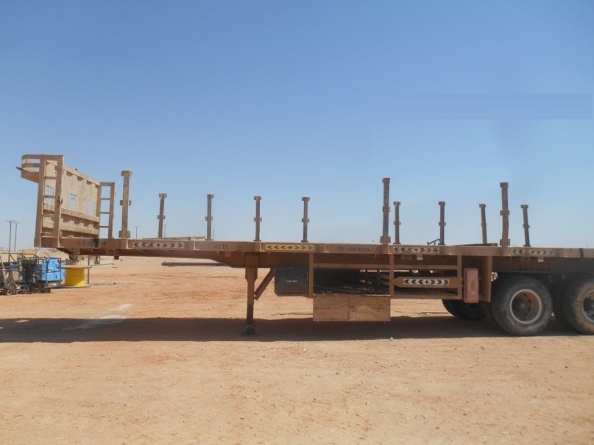
PDO Second Alert
Date: 26.09.2017 Incident: LTI
What happened?
Contractor driver was on top of a flatbed trailer (1.75m high) re-adjusting stanchions and dunnage in preparation for loading tubing. He lost consciousness falling from the trailer to the ground resulting in a fracture to his left forearm.
Your learning from this incident..
Carry out Stanchion and Dunnage placement on trailers from ground, if possible.
Ensure adequate supervision .
Ensure there is watchman on ground close to trailer to observe person working on top of the trailer.
Beware of Fall hazards while working at edge of trailer
Always have a watchman

Slide 2
Management self audit
Date: 26.09.2017 Incident: LTI
As a learning from this incident and ensure continual improvement all contract
managers must review their HSE HEMP against the questions asked below
Confirm the following:
Do you ensure your trailer bed have Antislip protective coating?
Do you ensure the provision of access and egress ladder for climbing on and off the trailer bed?
Do you ensure the condition of safety shoes at regular intervals?
Do you ensure sufficient provision of First Aiders in your teams?
Do you identify all hazards associated with loading and unloading of trailers?
Notes:
Make a list of closed questions (only ‘yes’ or ‘no’ as an answer) to ask other contractors if they have the same issues based on the management or HSE-MS failings or shortfalls identified in the investigation. Pretend you have to audit other companies to see if they could have the same issues.

