Slide 1
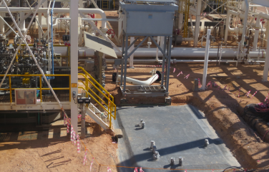
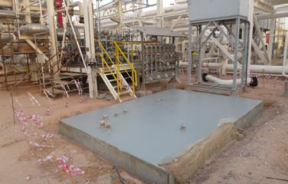
PDO Second Alert
Date: 15.12.2017 Incident title: LTI
What happened?
A Field Operator was attempting to reset the control panel. In doing so he stepped on the edge of the new skid foundation losing his balance and twisted his left leg.He was immediately sent to Yibal clinic whereby given first aid. He was then transported to Nizwa hospital for further medical evaluation where he was diagnosed with leg fracture.
Your learning from this incident..
Always make sure you have a proper access and agrees for areas under construction.
Avoid taking shortcuts while entering to the work site
Ensure you report any unsafe condition in your area
Avoid taking shortcuts

Slide 2
Management self audit
Date: 15.12.2017 Incident title: LTI
As a learning from this incident and ensure continual improvement all contract
managers must review their HSE HEMP against the questions asked below
Confirm the following:
Do you ensure supervisor carry out weekly plant inspection ?
Do you ensure that operator identify all hazards at workplace ?
Do you ensure that supervisors continue monitoring the site activates ?
Do your staff ensure that potential hazard of routine activities discussed and clear ?
Notes:
Make a list of closed questions (only ‘yes’ or ‘no’ as an answer) to ask other contractors if they have the same issues based on the management or HSE-MS failings or shortfalls identified in the investigation. Pretend you have to audit other companies to see if they could have the same issues.

