Slide 1
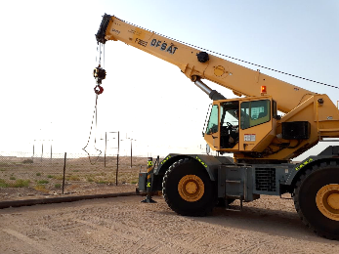
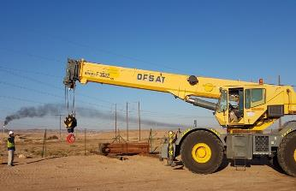
PDO Second Alert
Date: 27.12.2017 Incident title: HiPo OHL
What happened?
Your learning from this incident..
Always ensure adequate supervision and banksmen are available for crane operations
Always ensure you have a banksman when maneuvering your crane
Always ensure you follow the instructions of the foreman
Lower crane boom when maneuvering
Lifting slings must be secured and not free to swing or drag on the ground
Ensure you have received a brief and are aware of any nearby hazards
On the 27th December 2017 at approximately 17:30 hrs, during the move of a Rig in Saih Rawl, an crane after successfully completing a lift, was manoeuvring towards the rig pad parking area when it moved too close to an Over Head Power Line (OHPL) which was 8.7 meters high. This resulted in an electrical arc between the centre line of the OHPL’s and the sheave pin on the crane boom. The operator then immediately reversed the crane out of the danger area.
Crane maneuvering with boom up, lifting slings attached and no supervision
Ensure you lower your boom and use a banksman when close to overhead lines
Crane operating with boom lowered and under Supervision

Slide 2
Management self audit
Date: 27.12.2017 Incident title: HiPo OHL
As a learning from this incident and ensure continual improvement all contract
managers must review their HSE HEMP against the questions asked below
Confirm the following:
Do you ensure supervisors carry out dynamic risk assessments?
Do you ensure supervisors conduct task specific TBT’s/Reflective learnings where required?
Do you ensure all hazards are included in risk assessments and TBT’s?
Do you ensure adequate supervision to control the operations?
Do you ensure that all equipment is fully serviceable and capable of being operated?
Do you ensure learnings are disseminated to all required staff?
Notes:
Make a list of closed questions (only ‘yes’ or ‘no’ as an answer) to ask other contractors if they have the same issues based on the management or HSE-MS failings or shortfalls identified in the investigation. Pretend you have to audit other companies to see if they could have the same issues.

