Slide 1
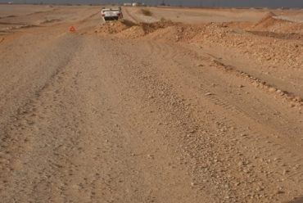
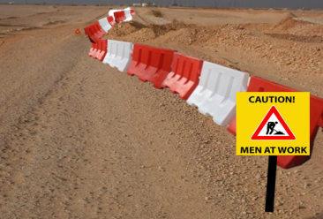
PDO Second Alert
Date: 18.11.2017 Incident title: HiPo MVI
What happened?
At about 0300hrs the driver (Floorman) was instructed to drop a driller who was complaining of stomach pain to the camp . After dropping him off and while driving back; at 0400hrs the driver hit a sand pile (about 3 km to reach the rig) then rolled over. The driver managed to come out without any injury and then called the rig through his mobile.
Your learning from this incident.
Wearing seat belt saves life.
Always Drive to road condition and follow the speed limits for different road types and timings.
Always officially report hazardous road conditions and missing road signs.
Never use Right of way “Pipe lines” Roads without authorization.
Position of the car after the rollover
Always Drive to road conditions
Properly Marked Road Hazards

Slide 2
Management self audit
Date: 18.11.2017 Incident title: HiPo MVI
As a learning from this incident and ensure continual improvement all contract
managers must review their HSE HEMP against the questions asked below
Confirm the following:
Do you ensure that Journey plan route is followed?
Do you ensure that drivers are adequately monitored?
Do you ensure there is communication regarding road conditions and missing signage?
Do you comply with SP 2000 V4 night driving requirements.
Notes:
Make a list of closed questions (only ‘yes’ or ‘no’ as an answer) to ask other contractors if they have the same issues based on the management or HSE-MS failings or shortfalls identified in the investigation. Pretend you have to audit other companies to see if they could have the same issues.

