Slide 1
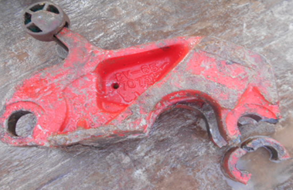
PDO Second Alert
Date:28.10.17 Incident title: HiPo Asset Damage
What happened?
.
Whilst breaking out the 6 1/2" Drill Collar using the Manual tong, the long jaw hinge pin and jaw parted. The long jaw including the latch assembly landed approximately 1 m away from the Driller’s console. No injury resulted from this incident.
Your learning from this incident..
Ensure periodic inspection and verification are conducted.
Ensure the inspections meet the required standards.
Verify the inspection reports and quarantine all defective equipment.
Always inform management of defective equipment immediately.
Sheared tong main jaw & parted pin
Always ensure defective equipment is removed from service

Slide 2
Management self audit
Date:28.10.17 Incident title: HiPo Asset Damage
As a learning from this incident and ensure continual improvement all contract managers must review their HSE HEMP against the questions asked below
Confirm the following:
Do you ensure adequate third inspection for critical items?
Do you ensure inspection and maintenance of critical equipment is monitored?
Do you ensure the right protocol of reporting defective equipment is followed?
Notes:
Make a list of closed questions (only ‘yes’ or ‘no’ as an answer) to ask other contractors if they have the same issues based on the management or HSE-MS failings or shortfalls identified in the investigation. Pretend you have to audit other companies to see if they could have the same issues.

