Slide 1
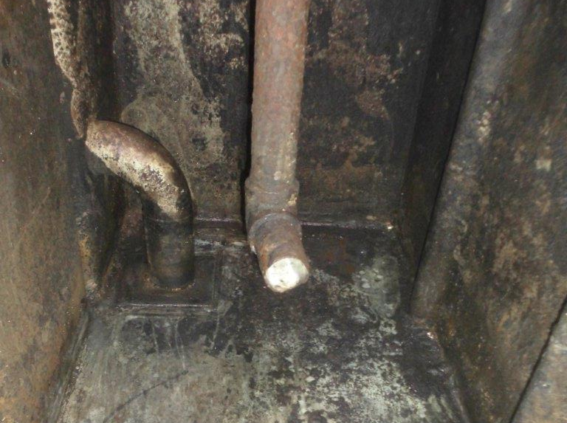
PDO Second Alert
Date: 26.10.2017 Incident title: HiPo Fire
What happened?
A welder was welding inside the intermediate brine tank to fix a leak on bottom of the tank. While carrying out this task, he heard a sound of air suction similar to opening of valve followed by a small amount of circulation water with oil residue entered the tank. The fluid made contact with the welding spark and caught fire. The welder immediately evacuated and alerted the crew members and crew put out the fire with portable fire extinguishers. No personal injury reported.
Your learning from this incident.
Always ensure lock out and tag out (LOTO) is in place prior to starting work.
Always ensure all connected lines are properly flushed prior to do welding in tanks.
Always ensure adequate Permit to Work is in place
Always ensure emergency evacuation is planned and rescue equipment is available.
Suction line through which the fluid came in
Welding area
Always follow the PTW procedures

Slide 2
Management self audit
Date: 26.10.2017 Incident title: HiPo Fire
As a learning from this incident and ensure continual improvement all contract
managers must review their HSE HEMP against the questions asked below
Confirm the following:
Do you ensure proper precautions are in place before any hot work?
Do you ensure implementation of lock out tag out procedure?
Do you ensure the PTW system is fully understood by Rig Managers?
Do you ensure monitoring of work to identify short cuts?
Do you ensure that the site team understand the term “physical isolation”?
Notes:
Make a list of closed questions (only ‘yes’ or ‘no’ as an answer) to ask other contractors if they have the same issues based on the management or HSE-MS failings or shortfalls identified in the investigation. Pretend you have to audit other companies to see if they could have the same issues.

