Slide 1
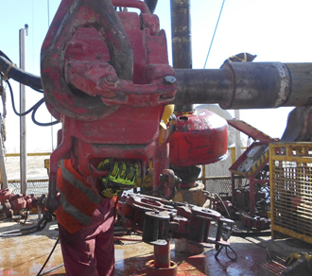
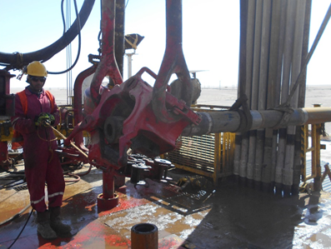
PDO Second Alert
Date:28.10.17 Incident title: HiPo Near Miss Incident
What happened?
.
The operation was laying down 6 ½’’ Drill Collar (DC) from the rig floor with two web slings secured to the crane. As the Floor man unlatched the elevator, it swung towards the draw works side and the DC towards the V-door side. The Floor man, was knocked off balance and fell backward onto the rig floor landing in a sitting position. No injury resulted from this incident.
Your learning from this incident..
Always ensure that you follow the safe method for laying down drill collars
Use the safe hands off method
Stay clear of the line of fire
Inform management immediately if any incident / near miss occurs.
Always intervene if you observe unsafe acts or conditions
Unlatching the Elevator without using winch
Always report Near Misses
Unlatching the Elevator using winch & Crane

Slide 2
Management self audit
Date: 28.10.17 Incident title: HiPo Near Miss
As a learning from this incident and ensure continual improvement all Contract Managers must review their HSE HEMP against the questions asked below
Confirm the following:
Do you ensure the staff competency process at all levels is managed effectively?
Do you ensure hands off methods are implemented on your sites?
Do you ensure that all near misses are reported?
Do you ensure that your operating procedures are followed?
Notes:
Make a list of closed questions (only ‘yes’ or ‘no’ as an answer) to ask other contractors if they have the same issues based on the management or HSE-MS failings or shortfalls identified in the investigation. Pretend you have to audit other companies to see if they could have the same issues.

