Slide 1
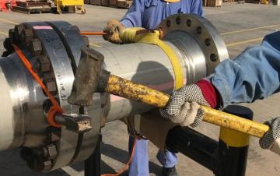
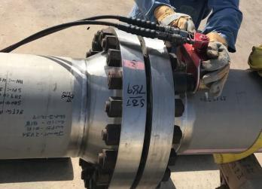
PDO Second Alert
Date: 22.07.2017 Incident: LTI
What happened?
A mechanical crew was engaged in removal of bolts from a flange as part of commissioning and de-spading activities. Whilst one of the crew members was hammering a spanner to remove bolts, a small splinter from the hammer cut through his cotton glove and hit his right index finger. This caused a minor superficial scratch injury on the finger. First Aid was given at site clinic and later he was diagnosed with partial tear on his right index finger extensor tendon which required a surgical repair.
Your learning from this incident..
Keep away from “line of fire” of tools and equipment
Always carry out pre use inspection and ensure regular maintenance of hand tools
Ensure all staff always use appropriate PPE for the job
Report all incidents immediately to comply with procedures
Always use the correct tools for the job

Slide 2
Management self audit
Date: 22.07.2017 Incident: LTI
As a learning from this incident and ensure continual improvement all contract
managers must review their HSE HEMP against the questions asked below
Confirm the following:
Do you ensure that employees are aware of the importance of immediately reporting of incidents?
Do you ensure that your team members are aware of the dangers of “Line of Fire”?
Do you ensure pre-use inspection and maintenance of hand tools?
Do you ensure that your employees are using right PPEs for the job?
Do you encourage your employees to intervene when they see an unsafe act or condition?
Do you ensure your work teams follow best practice when performing their tasks to ensure safety?
Notes:
Make a list of closed questions (only ‘yes’ or ‘no’ as an answer) to ask other contractors if they have the same issues based on the management or HSE-MS failings or shortfalls identified in the investigation. Pretend you have to audit other companies to see if they could have the same issues.

