Slide 1
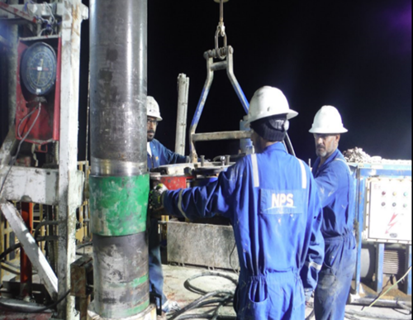
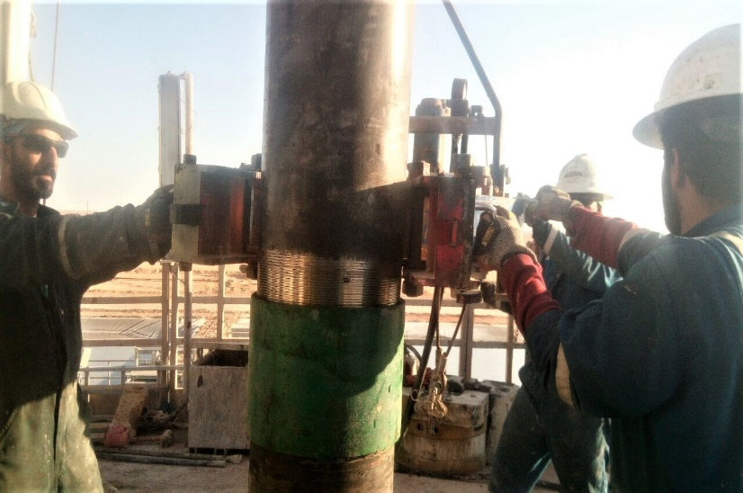
PDO Second Alert
Date: 30.12.2017 Incident: LTI
What happened?
During Running In hole of 9 5/8” casing, three of rig floor crew members were about to latch hydraulic casing power tong to the casing when IP left hand got trapped between the tong gate handle and casing joint resulting in fractures to his middles and ring fingers.
Your learning from this incident..
Always ensure you use the handles;
Always ensure pinch points are identified;
Always ensure hazards are identified prior to starting a task.
Always ensure hazards are communicated prior to starting a task
Keep Your Hands and Fingers away from
PINCH POINTS
Stable platform

Slide 2
Management self audit
Date: 30.12.2017 Incident: LTI
As a learning from this incident and ensure continual improvement all contract
managers must review their HSE HEMP against the questions asked below
Confirm the following:
Do you ensure all hazards and pinch points are identified and shared with your teams?
Do you ensure your supervisors are intervening with incorrect practices?
Do you ensure the quality of your TBT’s and communication between Supervisors and staff?
Do you ensure Near Misses are reported and investigated to prevent reoccurrences?
Notes:
Make a list of closed questions (only ‘yes’ or ‘no’ as an answer) to ask other contractors if they have the same issues based on the management or HSE-MS failings or shortfalls identified in the investigation. Pretend you have to audit other companies to see if they could have the same issues.

