Slide 1
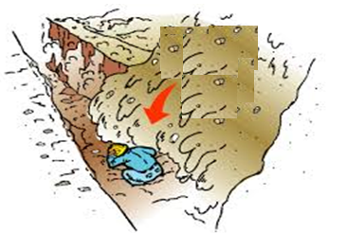
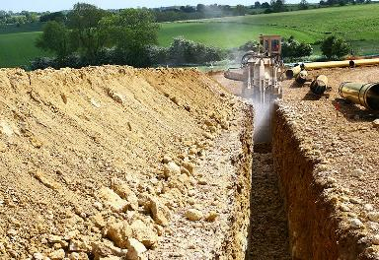
PDO Second Alert
Date: 06.05.2017 Incident: LTI
What happened?
During welding of a 6’’ pipe line a welder suffered fracture to his pelvis. He was working inside a trench when the soil stored on the side collapsed on to the pipe and it moved crushing the welder against the side wall.
Your learning from this incident..
Always ensure the surcharge load is half meter away from the trench.
Encourage peers to intervene in unsafe actions.
Always comply with planned activity at site.
Discuss line of fire in TRC sessions before start of job.
Provide feedback to the management incase of unsafe conditions and congested work areas at site.
Keep away from “Line of Fire”
Stable platform

Slide 2
Management self audit
Date: 06.05.2017 Incident: LTI
As a learning from this incident and ensure continual improvement all contract
managers must review their HSE HEMP against the questions asked below
Confirm the following:
Do you ensure urgent jobs are also planned and captured in change control ?
Do you ensure the crew uses correct trenching & excavation method as per PR 1002 ?
Do you ensure your permit holder identify & document the dynamic risk in case of any change ?
Do you ensure tool box talks include discussion on hazards identified during the completion of the task?
Does the supervisor ensure proper feedback from sites for change of design ?
Notes:
Make a list of closed questions (only ‘yes’ or ‘no’ as an answer) to ask other contractors if they have the same issues based on the management or HSE-MS failings or shortfalls identified in the investigation. Pretend you have to audit other companies to see if they could have the same issues.

