Slide 1
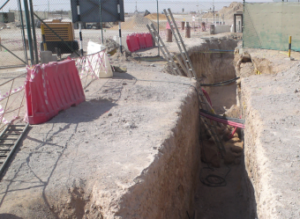
PDO Second Alert
Date: 30.09.2017 Incident: LTI
What happened?
A Civil crew was engaged in excavation for 30” via GRE piping. While digging the trench from 2.4m to 2.9 m depth, a part of the trench wall collapsed and fell on the ground worker who was using the jack hammer. Some soil fell on the other two crew members who were also working inside the trench. One of them was diagnosed with Pelvic fracture and other was diagnosed with minor contusion on right knee.
Your learning from this incident..
Always comply with procedures & apply MOC for any deviation.
Use Empowerment to STOP work policy if the work and site conditions are unsafe.
Always Intervene unsafe acts and behavior
Escalate safety concerns to the management.
worker.
Always use the appropriate methods/tools for gaining height for the activity.
Stable platform
Ensure to use the right tools and equipment for the activity

Slide 2
Management self audit
Date: 30.09.2017 Incident: LTI
As a learning from this incident and ensure continual improvement all contract
managers must review their HSE HEMP against the questions asked below
Confirm the following:
Do you conduct constructability review for design deliverables?
Do you ensure that your team members identify all opportunities to manager change effectively?
Do you ensure that the inspection for Excavations and other activities are carried out effectively?
Do you actively drive empowerment to stop policy?
Do you ensure that the planned work is realistic & achievable?
Notes:
Make a list of closed questions (only ‘yes’ or ‘no’ as an answer) to ask other contractors if they have the same issues based on the management or HSE-MS failings or shortfalls identified in the investigation. Pretend you have to audit other companies to see if they could have the same issues.

