Slide 1
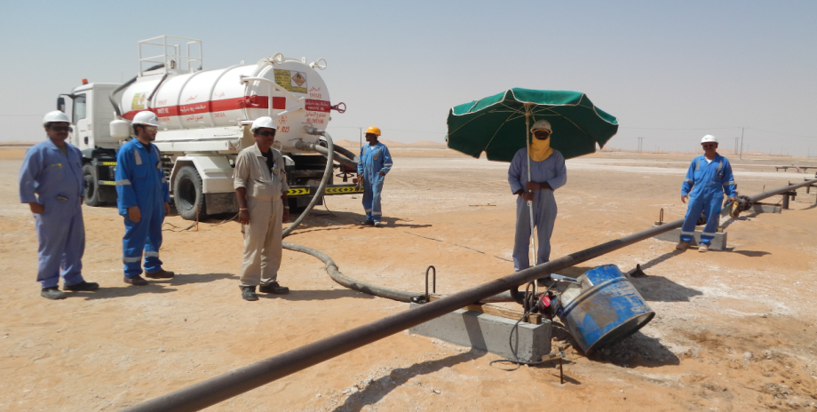
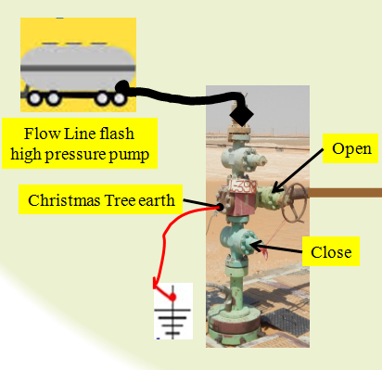
PDO Second Alert
Date: 25.09.2017 Incident: LTI
What happened?
Contractor requested to replace isolation valve on flow line L398 due to integrity issues with the existing isolation valve. Ignition occurred through an electrostatic discharge the resulting flash fire injured nearby Vacuum Tanker Driver Assistance.
Your learning from this incident..
Understanding of the executors PR-1073 requirement “Bonding/Grounding”
Bonding and grounding was not mentioned as part of PTW
No method statement attached in PTW due to lack of the procedure understanding.
Bonding and grounding was not verified as per PR-1073, neither by contractor, nor PDO because of lack of knowledge of the consequence and updated vacuum tanker procedure (PR-2282) the system was not yet approved for use.
Gas cloud
“Bonding/Grounding of the system Will prevent Ignition occurred through an electrostatic discharge”
Stable platform

Slide 2
Management self audit
Date: 25.09.2017 Incident: LTI
As a learning from this incident and ensure continual improvement all contract
managers must review their HSE HEMP against the questions asked below
Confirm the following:
Do you ensure that all parts of PTW are complete including bonding/grounding requirements applicable for drain jobs?
Do you ensure that all Permit holders are aware that dynamic risk assessments are to be done before resuming work after a break?
Do you ensure that dynamic risk assessments capture conditions that may have changed that may force a different approach in managing the task?
Do you ensure all operations/maintenance teams are aware of the hazards/risks (managing of potential ignition sources) when draining HC in a system open to air (e.g. through sharing information on similar incidents)? (following PR1073)
Notes:
Make a list of closed questions (only ‘yes’ or ‘no’ as an answer) to ask other contractors if they have the same issues based on the management or HSE-MS failings or shortfalls identified in the investigation. Pretend you have to audit other companies to see if they could have the same issues.

