Slide 1
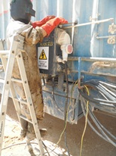
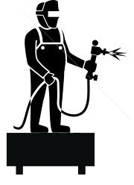
PDO Second Alert
Date: 05.03.2017 Incident: LTI
What happened?
At approximately 13:30 on 5th March 2017 a third party welder was standing on a step ladder to weld a shade on top of the Electric distribution board behind the Rig manager’s Office Caravan on the second step facing the caravan, when he tried to climb to third step, the ladder moved causing him to lose his balance falling to the ground, landing on his right wrist.
Your learning from this incident..
Always ensure step ladder is placed on level ground.
Provide effective on site supervision for third party worker.
Always use the appropriate methods/tools for gaining height for the activity.
Ensure to use the right tools and equipment for the activity
Stable platform

Slide 2
Management self audit
Date: 05.03.2017 Incident: LTI
As a learning from this incident and ensure continual improvement all contract
managers must review their HSE HEMP against the questions asked below
Confirm the following:
Do you ensure your TBT covers all associated hazards for the activity?
Does you site supervisor effectively supervise third party workers
Is your team empowered to stop any unsafe act /condition?
Do you ensure the required equipment is available for the activity?
Notes:
Make a list of closed questions (only ‘yes’ or ‘no’ as an answer) to ask other contractors if they have the same issues based on the management or HSE-MS failings or shortfalls identified in the investigation. Pretend you have to audit other companies to see if they could have the same issues.

