Slide 1
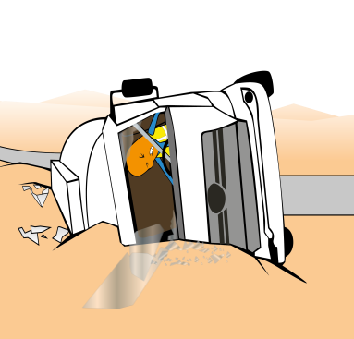
PDO Incident First Alert
Incident type | LTI (#12)
Date/ time | 14.05.18 @18:05hrs | Directorate
Location | Bahja | Dept
What happened
A water tanker driver and helper were at Bahja roundabout when the driver lost control of the vehicle resulting in the tanker tipping over on to its right side resulting in a multiple soft tissues injuries requiring surgical intervention.
Mr. Musleh asks the questions of can it happen to you?
Do you always adjust your speed on roundabouts?
Do you always apply defensive driving techniques?
Do you always ensure you and passengers wear seatbelts?
Please disseminate this LTI notification to your teams and use it in your tool box talks and HSE meetings and notice boards.

