Slide 1
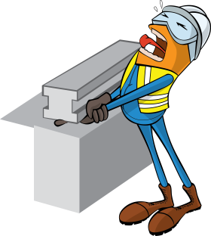
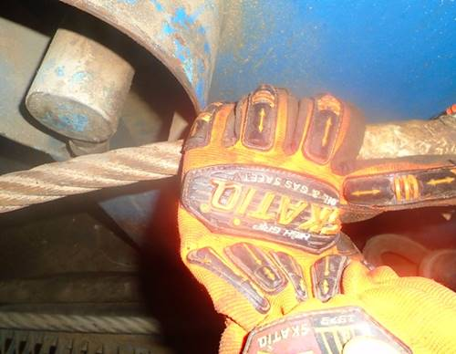


PDO Incident First Alert
Incident type | LTI (#13)
Date/ time | 16.05.18 @19:00hrs | Directorate
Location | Marmul | Dept
What happened
While rigging up, the Derrickman and Driller were pulling the guy lines away from the mast. While holding the same line the driller pulled on the line causing it to crush the Derrickman’s right hand against the draw-work’s body resulting in fracture to his right hand little finger.
Mr. Musleh asks the questions of can it happen to you?
Do you always ensure you communicate with your team member before moving to the next step?
Do you always wear your impact gloves?
Do you always consider the line of fire?
Please disseminate this LTI notification to your teams and use it in your tool box talks and HSE meetings and notice boards.

