Slide 1
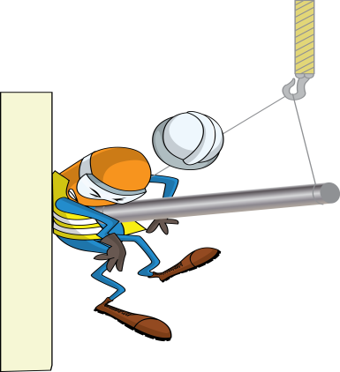
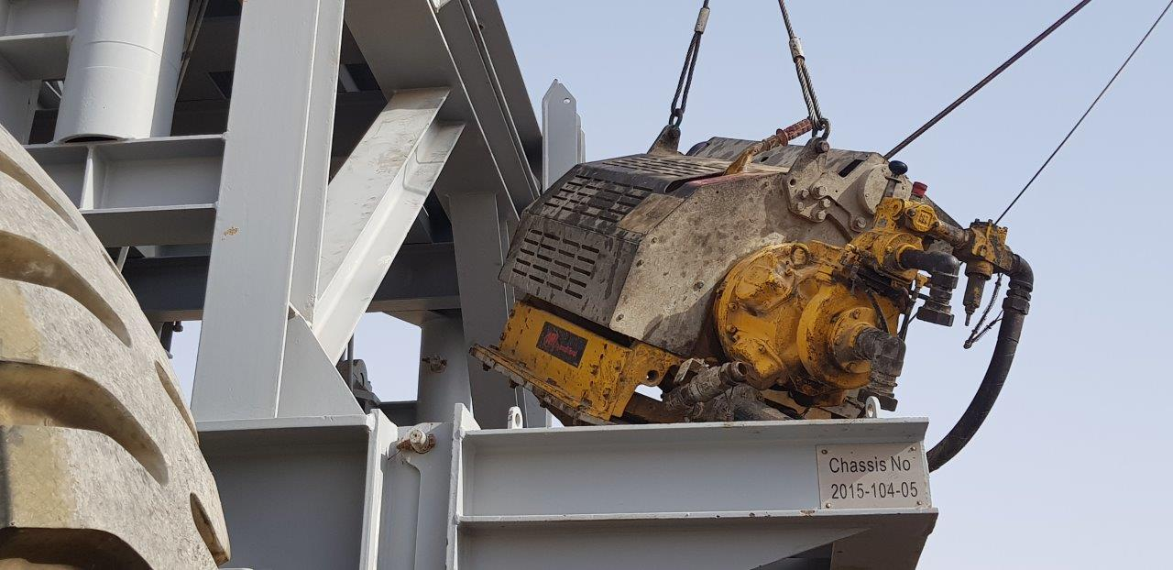


PDO Incident First Alert
Incident type | LTI (#14)
Date/ time | 15.06.18 @16:00hrs | Directorate
Location | Saih Rawl | Dept
What happened
While preparing to lower the mast the Roustabout attempted to align the air winch to the base of a dolly, while doing so the winch swung crushing his left arm between the dolly frame and winch resulting in a fracture to his left forearm.
Mr. Musleh asks the questions of can it happen to you?
Do you always ensure clear communication with your team members?
Do you always use tag lines or hands free tools to guide the load?
Do you ensure you & your team members are in a safe location?
Do you always consider the line of fire?
Crush point between Dolly post & winch.
Please disseminate this LTI notification to your teams and use it in your tool box talks and HSE meetings and notice boards.

