Slide 1
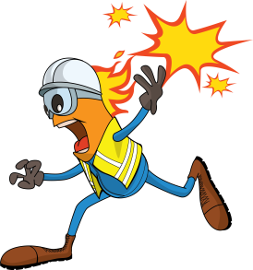
PDO Incident First Alert
Incident type | LTI (#15)
Date/ time | 26.06.18 @16:00hrs | Directorate
Location | Yibal-Khuff | Dept
What happened
While preparing chapatti’s for breakfast, a gas hose came off the burner igniting the gas, causing a fire. The Chapatti Maker was engulfed in the flames resulting in 3rd degree burns to 45% of his body.
Mr. Musleh asks the questions of can it happen to you?
Do you always check the gas connections?
Do you always ensure the gas detectors are installed in your kitchen?
Do you always consider the line of fire?
Point hose detached
Please disseminate this LTI notification to your teams and use it in your tool box talks and HSE meetings and notice boards.

