Slide 1

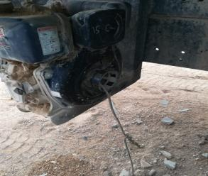



PDO Incident First Alert
Incident type | LTI (#16)
Date/ time | 01.07.18 @13:30hrs | Directorate
Location | Marmul | Dept
What happened
A driver was attempting to start the water pump using a pull start rope around the crank, when his left hand was dragged into the pumps mechanism amputating all four fingers on his left hand.
Mr. Musleh asks the questions of can it happen to you?
Do you ensure that guards and covers are in place on machinery?
Do you ensure you report damaged equipment immediately?
Do you consider what could go wrong?
Hand became entangled in motor
Please disseminate this LTI notification to your teams and use it in your tool box talks and HSE meetings and notice boards.

