Slide 1
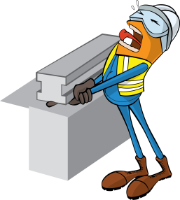
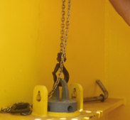
PDO Incident First Alert
Incident type | LTI (#17)
Date/ time | 08.07.18 @ 07:45 hrs | Directorate
Location | Mina Al Fahal | Dept
What happened
The diver was attempting to align the locking pin into the securing socket. When the pin dropped trapping his finger between the hoist hook and the locking pin pad eye resulting in the amputation of the tip of the right hand middle finger.
Mr. Musleh asks the questions of can it happen to you?
Do you ensure you have sufficient staff to do the job?
Do you consider what could go wrong?
Do you ensure you are out of the “Line of Fire”?
Pinch point
Please disseminate this LTI notification to your teams and use it in your tool box talks and HSE meetings and notice boards.

