Slide 1
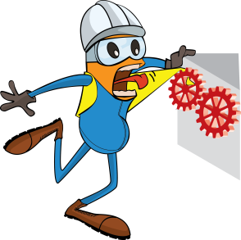
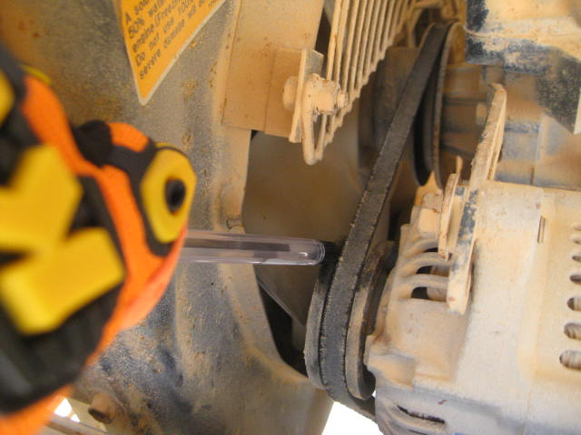
PDO Incident First Alert
Incident type | LTI (#18)
Date/ time | 09.07.18 @ 22:55 hrs | Directorate
Location | Amal | Dept
What happened
The Night Electrician was checking a fault with the rig’s tower light. As he began to check the alternator his colleague switched on the alternators belt pulling the Night Electrician left hand into the pulley and the belt resulting in a crush injury to the tip of the left hand middle finger.
Mr. Musleh asks the questions of can it happen to you?
Do you ensure you communicate with your co-workers?
Do you ensure you isolate the machines before checking them?
Do you ensure you are out of the “Line of Fire”?
The pinch point
Please disseminate this LTI notification to your teams and use it in your tool box talks and HSE meetings and notice boards.

