Slide 1
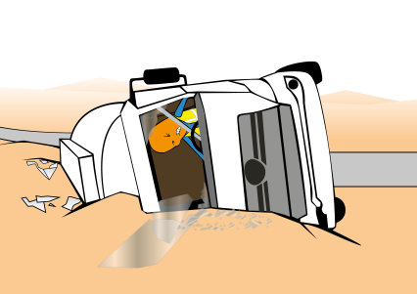
PDO Incident First Alert
Incident type | LTI (#19)
Date/ time | 02.07.18 @ 17:00 hrs | Directorate
Location | Muscat Express Road | Dept
What happened
Whilst travelling between Barka and Halban on the Express way, the driver lost control of the truck crashing through the central reservation crossing to the opposite carriage before rolling over resulting in the driver suffering a fractured back.
Mr. Musleh asks the questions of can it happen to you?
Do you ensure you check your vehicle prior to stating your journey?
Do you ensure you drive according to the road conditions?
Do you ensure the load is secure before driving?
Do you drive if you are fatigued?
Please disseminate this LTI notification to your teams and use it in your tool box talks and HSE meetings and notice boards.

